Slide 1
Chapter 7
Dynamic Programming

Slide 2
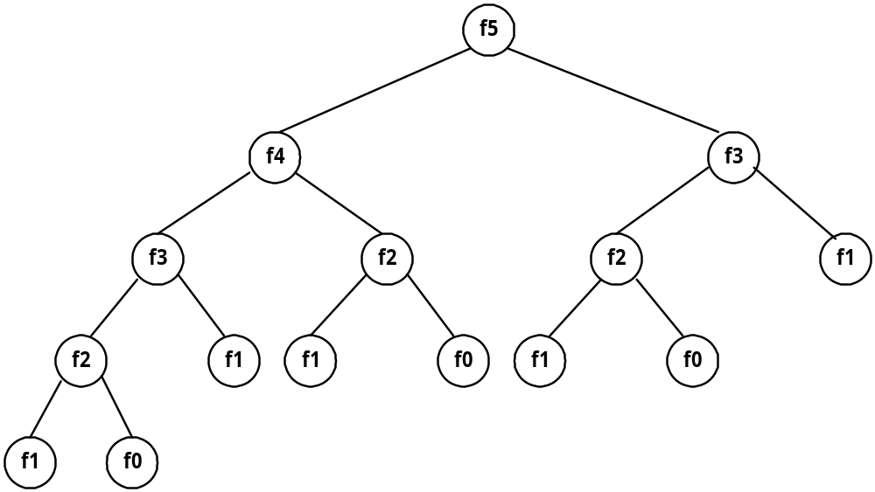
Fibonacci Sequence
Fibonacci sequence: 0 , 1 , 1 , 2 , 3 , 5 , 8 , 13 , 21 , …
F_{i} = i if i ≤ 1
F_{i} = F_{i-1} + F_{i-2} if i ≥ 2
Solved by a recursive program:
Much replicated computation is done.
It should be solved by a simple loop.

Slide 3
Dynamic Programming
Dynamic Programming is an algorithm design method that can be used when the solution to a problem may be viewed as the result of a sequence of decisions.

Slide 4
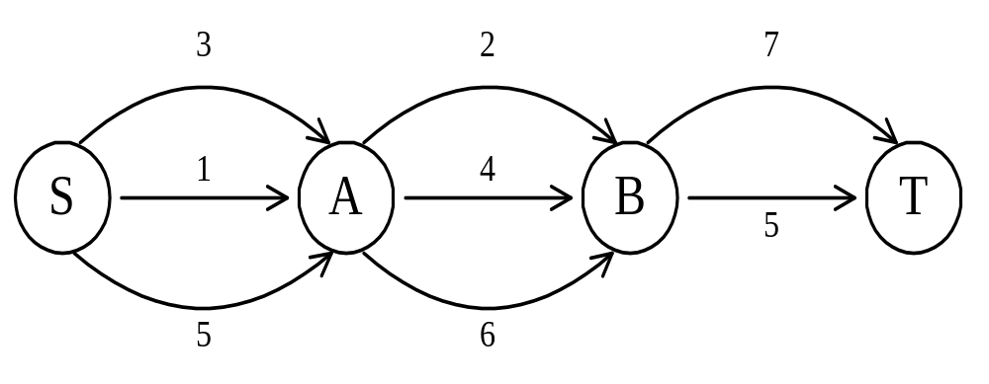
The Shortest Path
To find a shortest path in a multi-stage graph
Apply the greedy method:
the shortest path from S to T:
1 + 2 + 5 = 8.

Slide 5
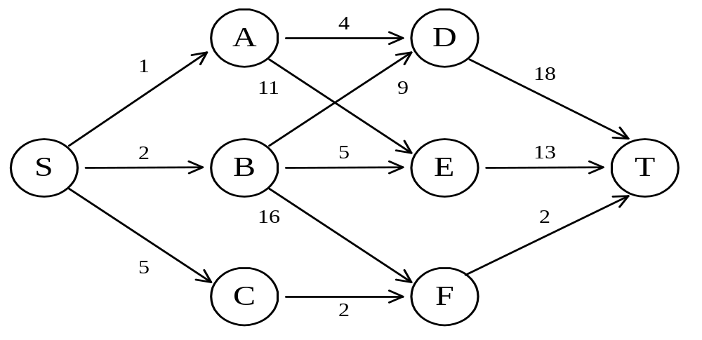
The Shortest Path in Multi-stage Graphs
e.g.
The greedy method cannot be applied to this case: (S, A, D, T) 1 + 4 + 18 = 23.
The real shortest path is:
(S, C, F, T) 5 + 2 + 2 = 9.

Slide 6
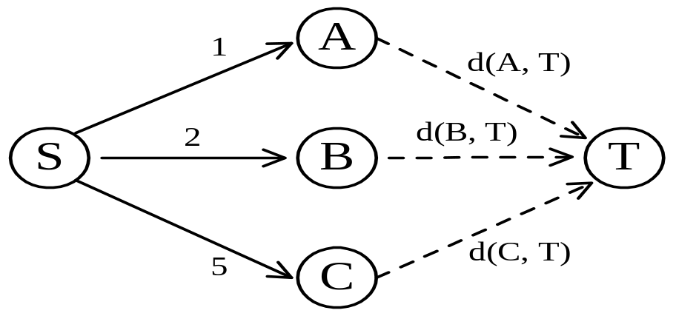
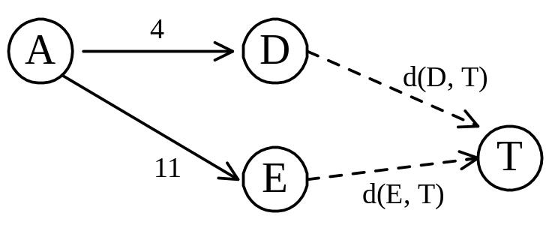
Dynamic Programming Approach
Dynamic programming approach (forward approach):
d(S, T) = min{1+d(A, T), 2+d(B, T), 5+d(C, T)}
d(A,T) = min{4+ d(D,T), 11+d(E,T)}
= min{4+18, 11+13} = 22.

Slide 7
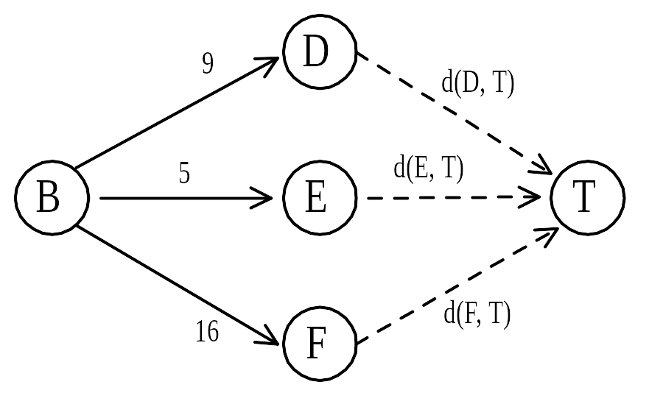
d(B, T) = min{9+d(D, T), 5+d(E, T), 16+d(F, T)}
= min{9+18, 5+13, 16+2} = 18.
d(C, T) = min{ 2+d(F, T) } = 2+2 = 4
d(S, T) = min{1+d(A, T), 2+d(B, T), 5+d(C, T)}
= min{1+22, 2+18, 5+4} = 9.
The above way of reasoning is called
backward reasoning.

Slide 8
Backward Approach
(Forward Reasoning)
d(S, A) = 1
d(S, B) = 2
d(S, C) = 5
d(S,D)=min{d(S, A)+d(A, D),d(S, B)+d(B, D)}
= min{ 1+4, 2+9 } = 5
d(S,E)=min{d(S, A)+d(A, E),d(S, B)+d(B, E)}
= min{ 1+11, 2+5 } = 7
d(S,F)=min{d(S, A)+d(A, F),d(S, B)+d(B, F)}
= min{ 2+16, 5+2 } = 7

Slide 9
d(S,T) = min{d(S, D)+d(D, T),d(S,E)+
d(E,T), d(S, F)+d(F, T)}
= min{ 5+18, 7+13, 7+2 }
= 9

Slide 10
Principle of Optimality
Principle of optimality: Suppose that in solving a problem, we have to make a sequence of decisions D₁, D₂, …, D_{n}. If this sequence is optimal, then the last k decisions, 1 < k < n must be optimal.
e.g. the shortest path problem
If i, i₁, i₂, …, j is a shortest path from i to j, then i₁, i₂, …, j must be a shortest path from i₁ to j
In summary, if a problem can be described by a multi-stage graph, then it can be solved by dynamic programming.

Slide 11
Dynamic Programming
Forward approach and backward approach:
  If the recurrence relations are formulated using the forward approach, the relations are solved backward, i.e., beginning with the last decision.
  If the relations are formulated using the backward approach, they are solved forwards.
To solve a problem by using dynamic programming:
  Find out the recurrence relations.
  Represent the problem by a multi-stage graph.

Slide 12
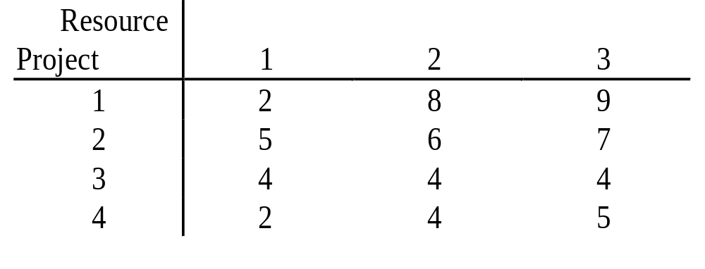
The Resource Allocation Problem
m resources, n projects
p(i, j): the profit obtained when j resources are allocated to project i.
Maximize the total profit.

Slide 13
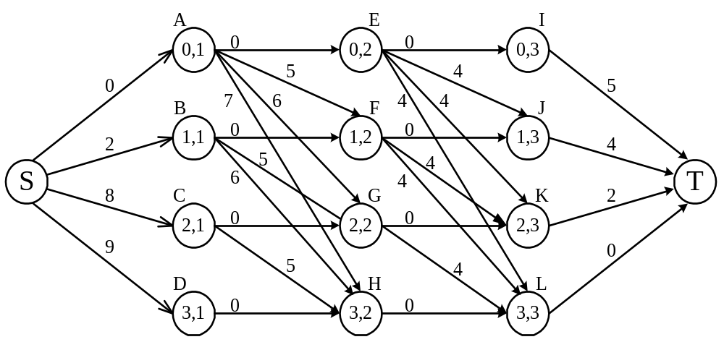
The Multi-Stage Graph Solution
The resource allocation problem can be described as a multi-stage graph.
(i, j): i resources allocated to projects 1, 2, …, j
e.g. node H = (3, 2): 3 resources allocated to projects 1, 2.

Slide 14
Find the longest path from S to T:
(S, C, H, L, T), 8 + 5 + 0 + 0 = 13.
2 resources allocated to project 1.
1 resource allocated to project 2.
0 resource allocated to projects 3, 4.

Slide 15
The Longest Common Subsequence (LCS) problem
A string: A = b a c a d
A subsequence of A: deleting 0 or more symbols from A (not necessarily consecutive).
e.g. ad, ac, bac, acad, bacad, bcd.
Common subsequences of A = b a c a d and
B = a c c b a d c b : ad, ac, bac, acad.
The longest common subsequence (LCS) of A and B:
a c a d.

Slide 16
The LCS Algorithm
Let A = a₁ a₂ … a_{m} and B = b₁ b₂ … b_{n}
Let L_{i,j} denote the length of the longest common subsequence of a₁ a₂ … a_{i} and b₁ b₂ … b_{j.}
L_{i,j} = L_{i-1,j-1} + 1 if a_{i}=b_{j}
max{ L_{i-1,j}, L_{i,j-1} } if a_{i}≠b_{j}
L_{0,0} = L_{0,j} = L_{i,0} = 0 for 1≤i≤m, 1≤j≤n.

Slide 17
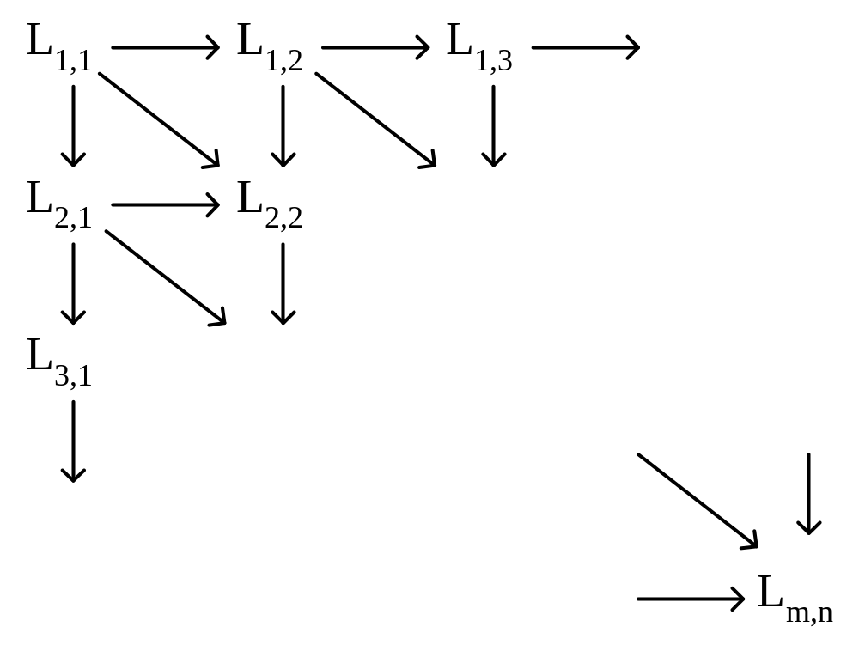
The dynamic programming approach for solving the LCS problem:
Time complexity: O(mn)

Slide 18
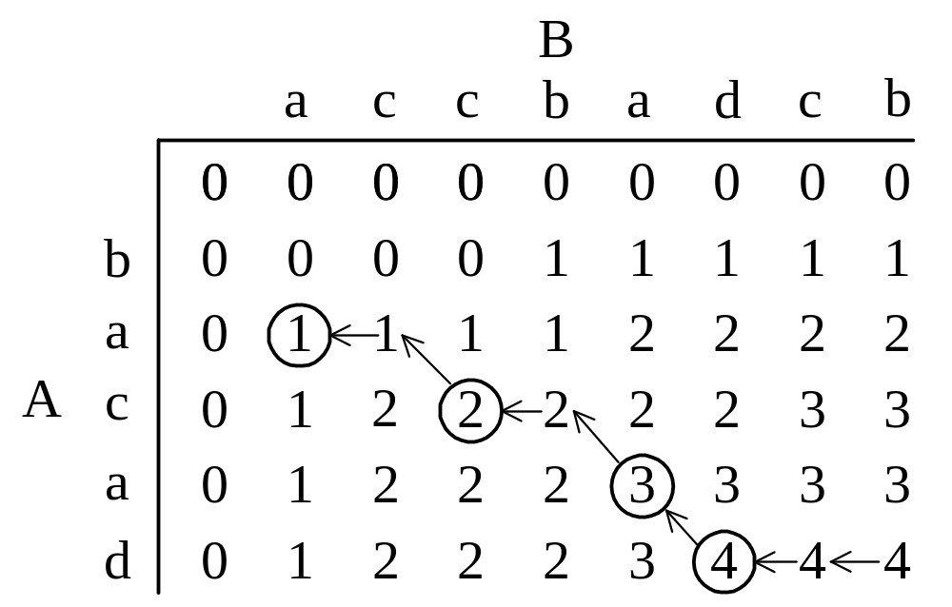
Tracing Back in the LCS Algorithm
e.g. A = b a c a d, B = a c c b a d c b
After all L_{i,j}’s have been found, we can trace back to find the longest common subsequence of A and B.

Slide 19
The Two-Sequence Alignment Problem
Sequence alignment may be viewed as a method to measure the similarity of two sequences
Let A = a₁ a₂ … a_{m} and B = b₁ b₂ … b_{n}
A sequence alignment of A and B : a 2×k matrix M (k ≥ m, n ) of characters over Σ ∪ {-}.
  e.g.
  if A = a b c d and B = c b d.
  a possible alignment of them would be:
  a b c - d
  - - c b d

Slide 20
Let f(x, y) denote the score for aligning x with y.
If x and y are the same, f(x, y)= 2.
If x and y are not the same, f(x, y)= 1.
If x or y is “-“, f(x, y)= -1.
e.g.
A= a b c d
  B= c b - d
  The total score of the alignment is 1+ 2 – 1 + 2 = 4.

Slide 21
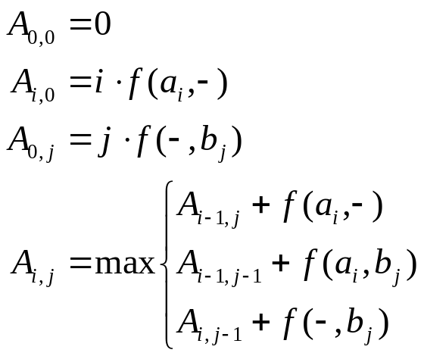
Let A_{i,j} denote the optimal alignment score between a₁ a₂ … a_{i} and b₁ b₂ … b_{j} and, where 1≤ i≤ m and 1≤ j ≤ n.
Then, A_{i,j} can be expressed as follows:
A_{i,0} : a₁ a₂ … a_{i} are all aligned with “-”.
A_{0,j} : b₁ b₂ … b_{j} are all aligned with “-”.
f(a_{i} ,-): a_{i} is aligned with “-”.
f(a_{i} ,b_{j}): a_{i} is aligned with b_{j}.
f(- ,b_{j}): b_{j} is aligned with “-”.

Slide 22
The A_{i,j}’s for A = a b d a d and B = b a c d using the above recursive formula are listed below:
a_{i} b_{j} |  |  | a | b | d | a | d
 |  | 0 | 1 | 2 | 3 | 4 | 5
 | 0 | 0 | -1 | -2 | -3 | -4 | -5
b | 1 | -1 | 1 | 1 | 0 | -1 | -2
a | 2 | -2 | 1 | 2 | 2 | 2 | 1
c | 3 | -3 | 0 | 2 | 3 | 3 | 3
d | 4 | -4 | -1 | 1 | 4 | 4 | 5

Slide 23
In the above table, we have also recorded how each A_{i,j} is obtained.
An arrow from (a_{i},b_{j}) to (a_{i-1},b_{j-1}): a_{i} matched with b_{j}.
An arrow from (a_{i},b_{j}) to (a_{i-1},b_{j}): a_{i} matched with “-”,
An arrow from (a_{i},b_{j}) to (a_{i},b_{j-1}): b_{j} matched with “-”.
Based upon the arrows in the table, we can trace back and find the optimal alignment is as follows:
a b d a d
- b a c d

Slide 24
Edit Distance
Edit Distance is also used quite often to measure the similarity between two sequences.
Transform A to B by three edit operations:
  deletion of a character from A.
  insertion of a character into A.
  substitution of a character in A with another character.

Slide 25
For example
  Let A = GTAAHTY and B = TAHHYC
  (1) Delete the first character G of A.
  GTAAHTY → TAAHTY
  (2) Substitute the third character of A by H.
  TAAHTY → TAHHTY
  (3) Delete the fifth character of A.
  TAHHTY → TAHHY
  (4) Insert C after the last character of A. TAHHY → TAHHYC = B

Slide 26
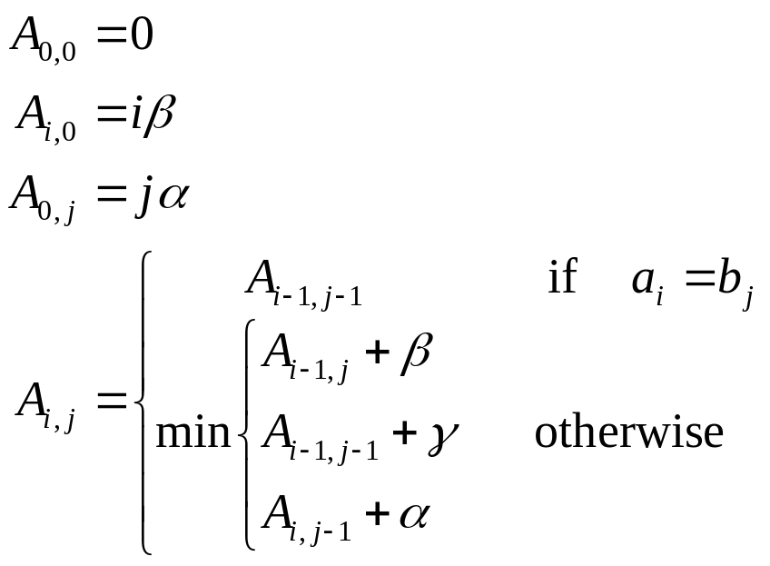
Associate a cost with each operation.
  Let α, β and γ denote the costs of insertion, deletion and substitution respectively.
  A_{i,j} : the edit distance between a₁ a₂ .. a_{i} and b₁ b₂ ..b_{j.}
  It takes O(nm) time to find an optimal alignment.

Slide 27
The RNA Maximum Base Pair Matching Problem
Ribonucleic acid (RNA) is a single strand of nucleotides (bases) adenine (A), guanine (G), cytosine (C) and uracil (U).
The sequence of the bases A, G, C and U is called the primary structure of an RNA.
The primary structure of an RNA can fold back on itself to form its secondary structure.
  G and C can form a base pair G≡C by a triple-hydrogen bond.
  A and U can form a base pair A=U by a double-hydrogen bond.
  G and U can form a base pair G−U by a single hydrogen bond.

Slide 28
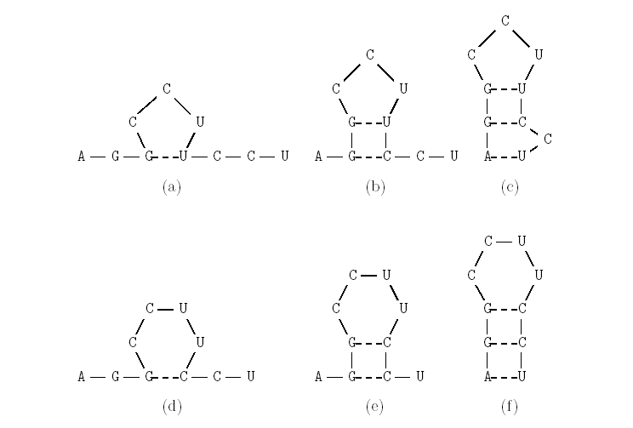
E.g.
  The primary structure of an RNA, R:
  A–G–G–C–C–U–U–C–C–U
  Six possible secondary structures of RNA, R:

Slide 29
An RNA sequence will be represented as a string of n characters R = r₁r₂ · · ·r_{n}, where r_{i} {A, C, G, U}.
A secondary structure of R is a set S of base pairs (r_{i}, r_{j}), where 1 ≤ i < j ≤ n.
  (1) j - i > t, where t is a small positive constant. Typically, t = 3.
  (2) If (r_{i}, r_{j}) and (r_{k}, r_{l}) are two base pairs in S and i ≠ k, then either
(a) i = k and j = l, i.e., (r_{i}, r_{j}) and (r_{k}, r_{l}) are the same
base pair,
(b) i < j < k < l, i.e., (r_{i}, r_{j}) precedes (r_{k}, r_{l}), or
(c) i < k < l < j, i.e., (r_{i}, r_{j}) includes (r_{k}, r_{l}).
Pseudoknot: Two base pairs (r_{i}, r_{j}) and (r_{k}, r_{l}) ,if i < k < j < l
Due to different hydrogen bonds, the energies of base pairs are usually assigned different values. For example, the reasonable values for A≡U, G=C and G–U are -3, -2 and -1, respectively.

Slide 30
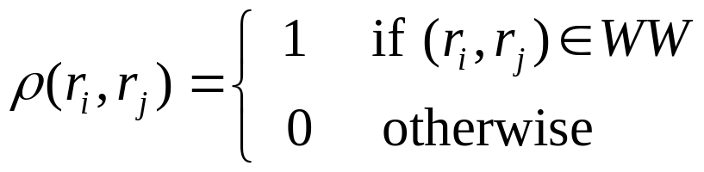
Dynamic Programming
Given an RNA sequence R = r₁r₂ · · ·r_{n}, find a secondary structure of RNA with the maximum number of base pairs.
Let S_{i,j} denote the secondary structure of the maximum number of base pairs on the substring R_{i,j} = r_{i}r_{i+1} · · · r_{j}.
Denote the number of matched base pairs in S_{i,j} by M_{i,j} .
If j - i ≤ 3, then r_{i} and r_{j} cannot be a base pair of S_{i,j} and M_{i,j} = 0 .
Let WW = {(A, U), (U, A), (G, C), (C, G), (G, U), (U, G)}.
ρ(r_{i}, r_{j}) : whether any two bases r_{i} and r_{j} can be a legal base pair:

Slide 31
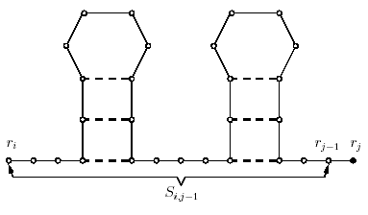
To compute M_{i,j}, where j- i > 3, we consider the following cases from r_{j}’s point of view.
  Case 1: In the optimal solution, r_{j} is not paired with any other base. In this case, find an optimal solution for r_{i}r_{i+1} . . . r_{j-1} and M_{i,j} =M_{i,j-1}.

Slide 32
  Case 2: In the optimal solution, r_{j} is paired with r_{i}. In this case, find an optimal solution for r_{i+1}r_{i+2} . . . r_{j-1} and M_{i,j} = 1 + M_{i+1,j-1}.

Slide 33
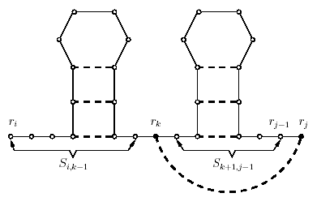
  Case 3: In the optimal solution, r_{j} is paired with some r_{k}, where i + 1 ≤ k ≤ j - 4. In this case, find the optimal solutions for r_{i}r_{i+1} . . . r_{k-1} and r_{k+1}r_{k+1} . . . r_{j-1} and M_{i,j} = 1 + M_{i,k-i}+ M_{k+1,j-1}.

Slide 34
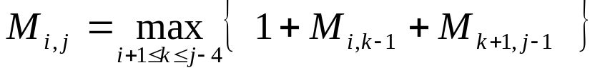
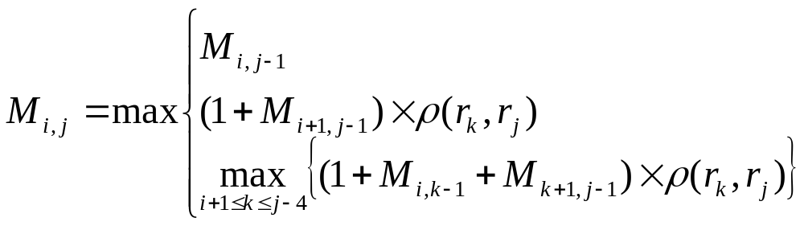
Find the k between i+1 and j+ 4 such that M_{i,j} is the maximum, we have
Compute M_{i,j} by the following recursive formula
    If j - i ≦ 3, then M_{i,j} = 0.
    If j - i > 3, then

Slide 35
The following table illustrates the computation of M_{i,j}, where 1 ≤ i < j ≤ 10, for an RNA sequence R_{1,10} = A–G–G–C–C–U–U–C–C–U.
Maximum number of base pairs in S_{1,10} is 3 since M_{1,10} = 3.
i\j | 1 | 2 | 3 | 4 | 5 | 6 | 7 | 8 | 9 | 10
1 | 0 | 0 | 0 | 0 | 0 | 1 | 2 | 2 | 2 | 3
2 | - | 0 | 0 | 0 | 0 | 1 | 1 | 2 | 2 | 2
3 | - | - | 0 | 0 | 0 | 0 | 1 | 1 | 1 | 1
4 | - | - | - | 0 | 0 | 0 | 0 | 0 | 0 | 0
5 | - | - | - | - | 0 | 0 | 0 | 0 | 0 | 0
6 | - | - | - | - | - | 0 | 0 | 0 | 0 | 0
7 | - | -- | - | - | - | - | 0 | 0 | 0 | 0
8 | - | - | - | - | - | - | - | 0 | 0 | 0
9 | - | - | - | - | - | - | - | - | 0 | 0
10 | - | - | - | - | - | - | - | - | - | 0

Slide 36
Algorithm to Compute M_{1,n}
Input: An RNA sequence R = r₁r₂ · · · r_{n}.
Output: Find a secondary structure of RNA with the maximum number of base pairs.
Step 1: /* Computation of ρ(r_{i}, r_{j}) function for 1 ≤ i < j ≤ n */
WW = {(A, U), (U, A), (G, C), (C, G), (G, U), (U, G)};
for i = 1 to n do
for j = i to n do
if (r_{i}, r_{j}) WW then ρ(r_{i}, r_{j}) = 1; else ρ(r_{i}, r_{j}) = 0;
end for
end for

Slide 37
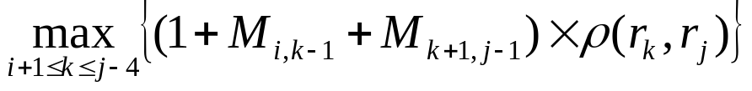
Step 2: /* Initialization of M_{i,j} for j - i ≤ 3 */
for i = 1 to n do
for j = i to i + 3 do
if j ≦ n then M_{i,j} = 0;
end for
end for
Step 3: /* Calculation of M_{i,j} for j - i > 3 */
for h = 4 to n - 1 do
for i = 1 to n - h do
j = i + h;
case1 = M_{i,j-1};
case2 = (1+M_{i+1,j-1}) × ρ(r_{i}, r_{j} );
case3 =
M_{i,j} = max{case1, case2, case3};
end for
end for
Time-complexity : O(n³).

Slide 38
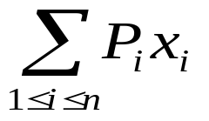
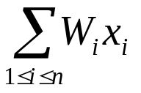
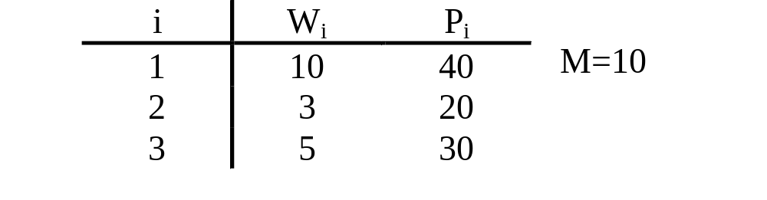
0/1 Knapsack Problem
n objects , weights W₁, W₂, …,W_{n}
profits P₁, P₂, …,P_{n}
capacity M
maximize
subject to ≤ M
x_{i} = 0 or 1, 1≤i≤n
e.g.

Slide 39
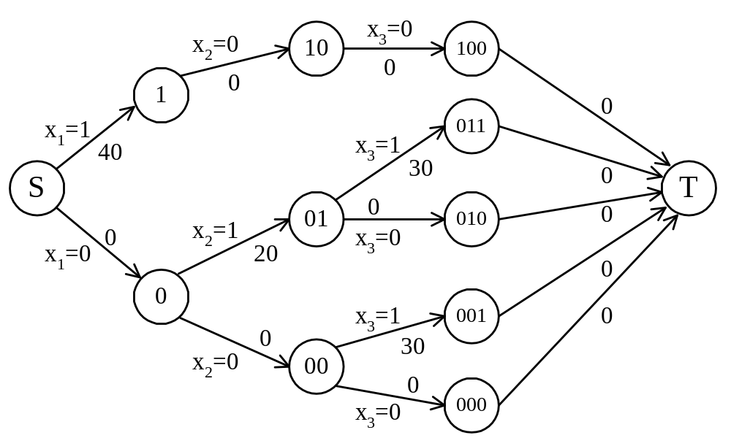
The Multi-Stage Graph Solution
The 0/1 knapsack problem can be described by a multi-stage graph.

Slide 40
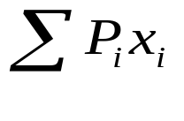
The Dynamic Programming Approach
The longest path represents the optimal solution:
x₁=0, x₂=1, x₃=1
= 20+30 = 50
Let f_{i}(Q) be the value of an optimal solution to objects 1,2,3,…,i with capacity Q.
f_{i}(Q) = max{ f_{i-1}(Q), f_{i-1}(Q-W_{i})+P_{i} }
The optimal solution is f_{n}(M).

Slide 41
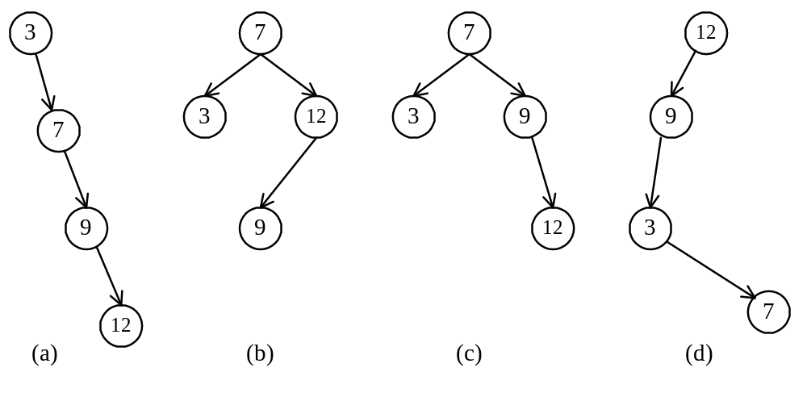
Optimal Binary Search Trees
e.g. binary search trees for 3, 7, 9, 12;

Slide 42
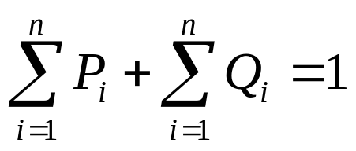
Optimal Binary Search Trees
n identifiers : a₁ <a₂ <a₃ <…< a_{n}
P_{i}, 1≤i≤n : the probability that a_{i} is searched.
Q_{i}, 0≤i≤n : the probability that x is searched
where a_{i} < x < a_{i+1} (a₀=-∞, a_{n+1}=∞).

Slide 43
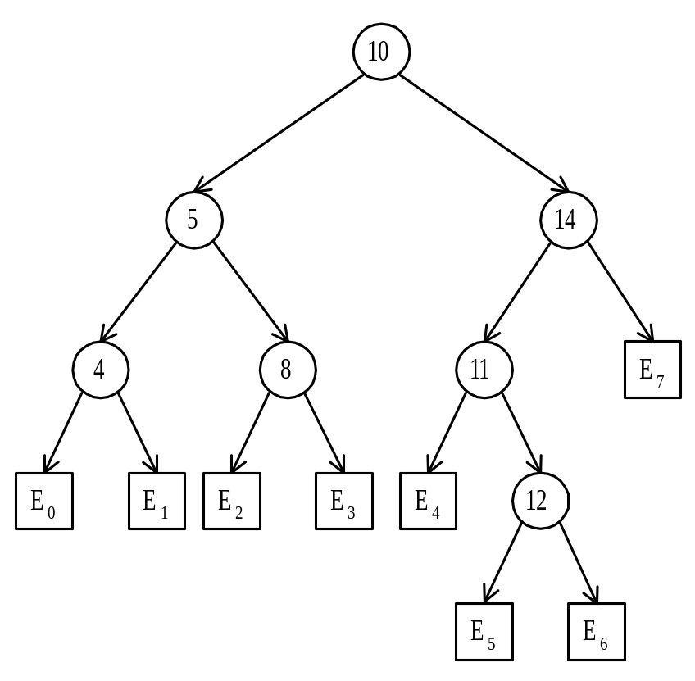
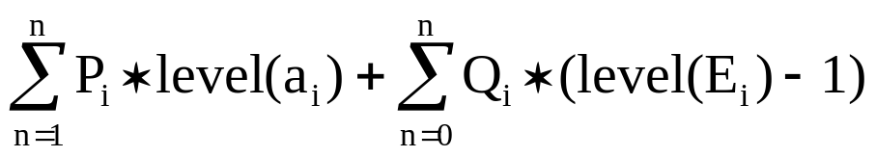
Identifiers : 4, 5, 8, 10, 11, 12, 14
Internal node: successful search, P_{i}
External node: unsuccessful search, Q_{i}
The expected cost of a binary tree:
The level of the root: 1

Slide 44
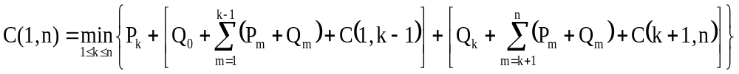
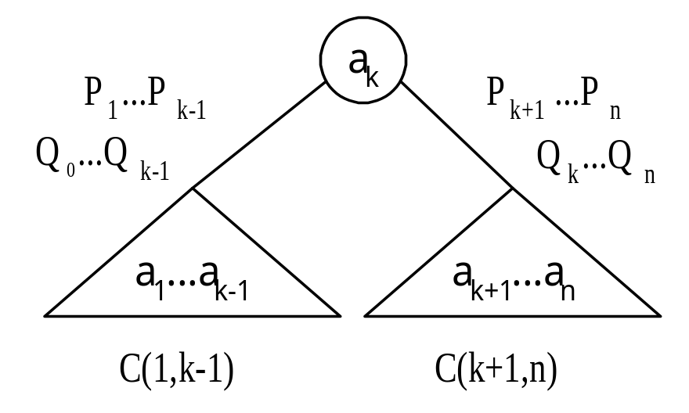
The Dynamic Programming Approach
Let C(i, j) denote the cost of an optimal binary search tree containing a_{i},…,a_{j} .
The cost of the optimal binary search tree with a_{k} as its root:

Slide 45
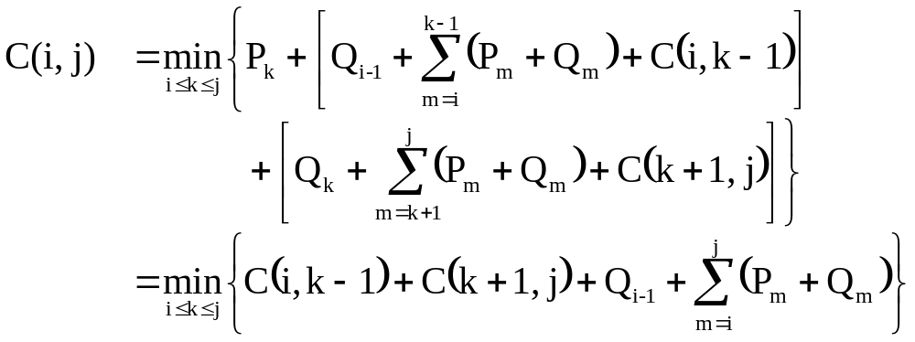
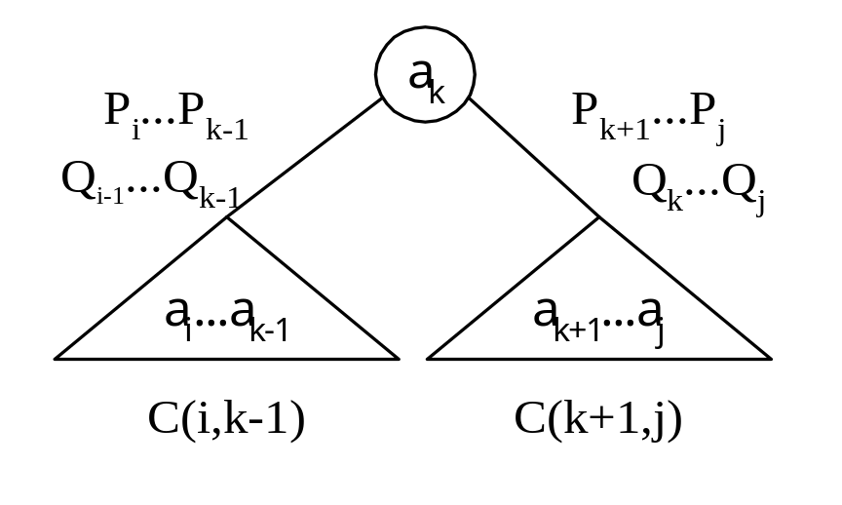
General Formula

Slide 46
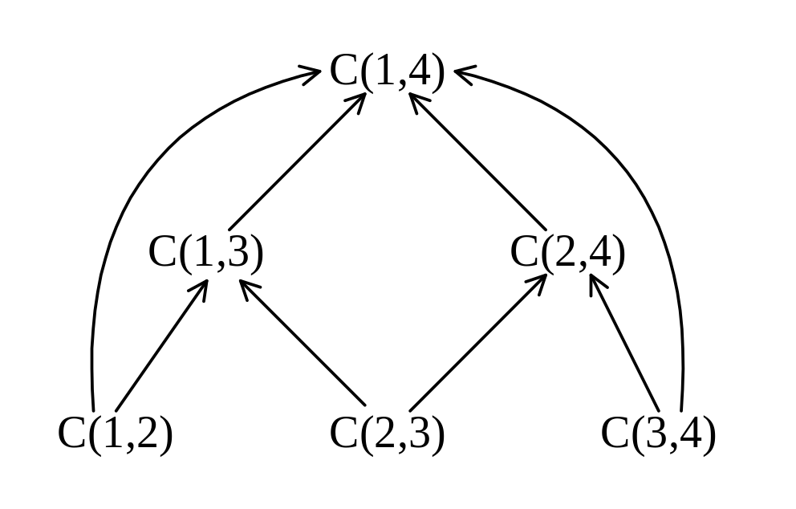
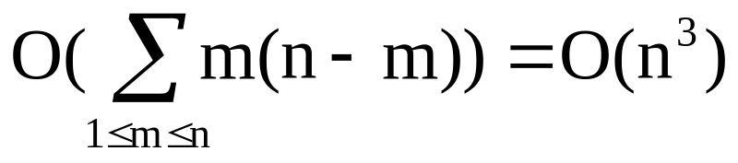
Computation Relationships of Subtrees
e.g. n = 4
Time complexity: O(n³)
(n-m) C(i, j)’s are computed when j - i = m.
Each C(i, j) with j – i = m can be computed in O(m) time.

